Slide 1
Denoising Graph Auto-Encoders on Heterogeneous Information Networks for Cold-start Recommendation
Source: KDD '21
Speaker: Po-Jen, Wen
Advisor: Jia-Ling, Koh
Date: 2021/11/09

Slide 2
OUTLINE
Introduction
Method
Experiment
Conclusion

Slide 3
OUTLINE
Introduction
Motivation
Input and output
Challenges

Slide 4
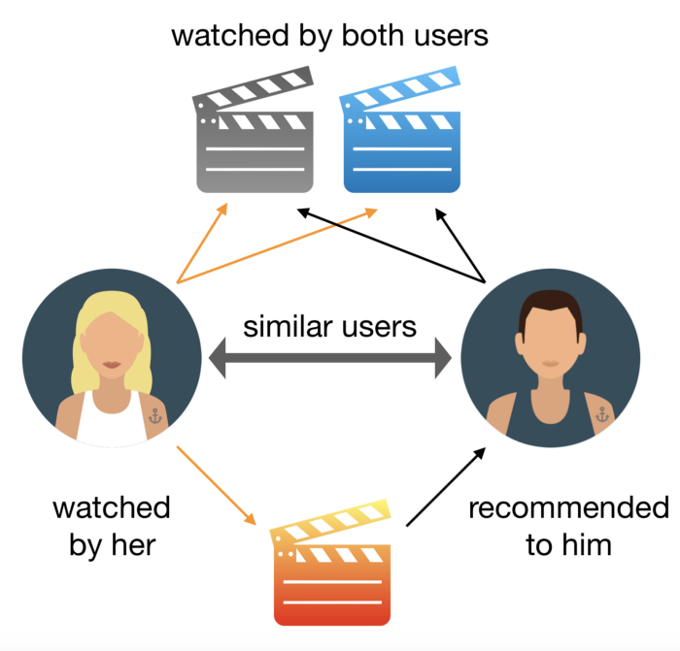
Motivation
Recommender systems:
Provide a user with few items that he/she would like

Slide 5
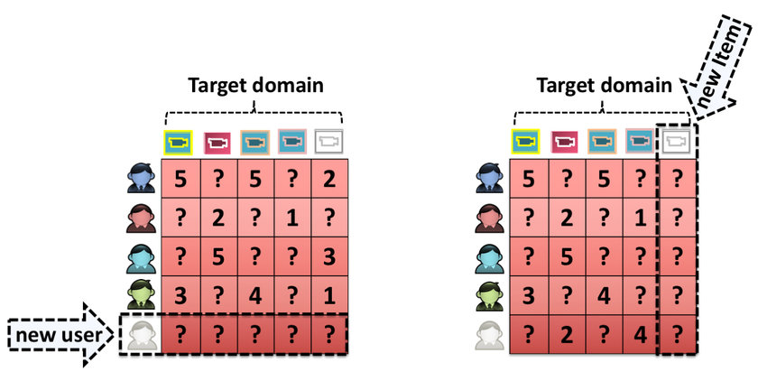
Motivation
Cold-start Problem
New users or new items
The interaction data is very sparse

Slide 6
Motivation
Regarding cold-start as a missing data problem where user-item interaction data is missing.
Design a novel model name Multi-view Denoising Graph Auto-Encoders (MvDGAE) on HINs

Slide 7
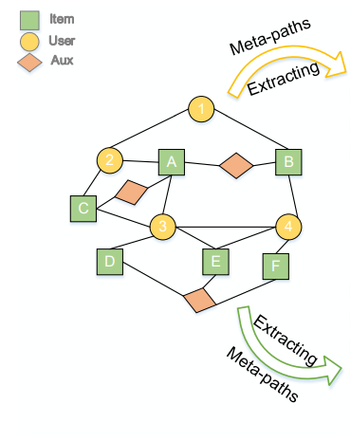
Input & Output
MvDGAE
Heterogeneous Information Networks (HIN)
G = (V, E, A, R)
V: sets of nodes
E: sets of edges
A: sets of node types
R: sets of edge types
The predict score of user and item

Slide 8
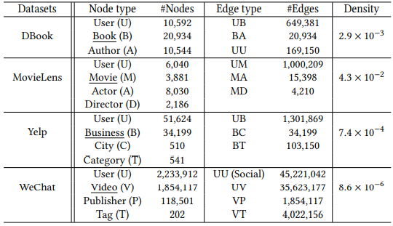
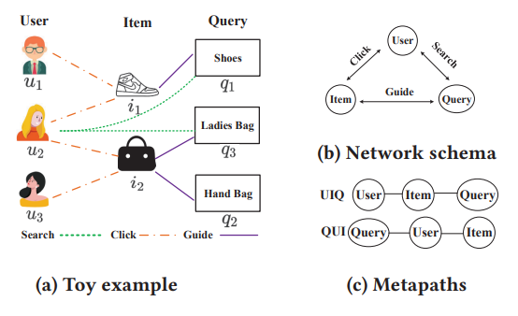
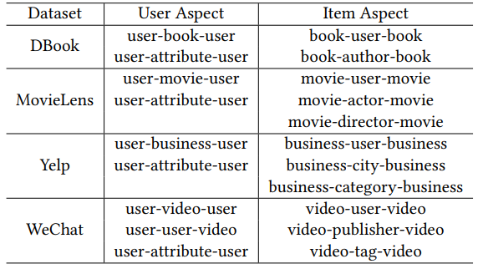
Input & Output
Heterogeneous Information Networks (HIN)
G = (V, E, A, R)
V: sets of nodes
E: sets of edges
A: sets of node types
R: sets of edge types

Slide 9
Challenges
How to learn Informative Embedding for both users and items with limited information?
How to deal with the Gap between Training and Inference procedures in cold-start scenarios?

Slide 10
OUTLINE
Method
Overall Framework
Multi-view Graph Encoder
Multi-view Graph Decoding
Bayesian Task Weight Learner
Optimization Objective

Slide 11
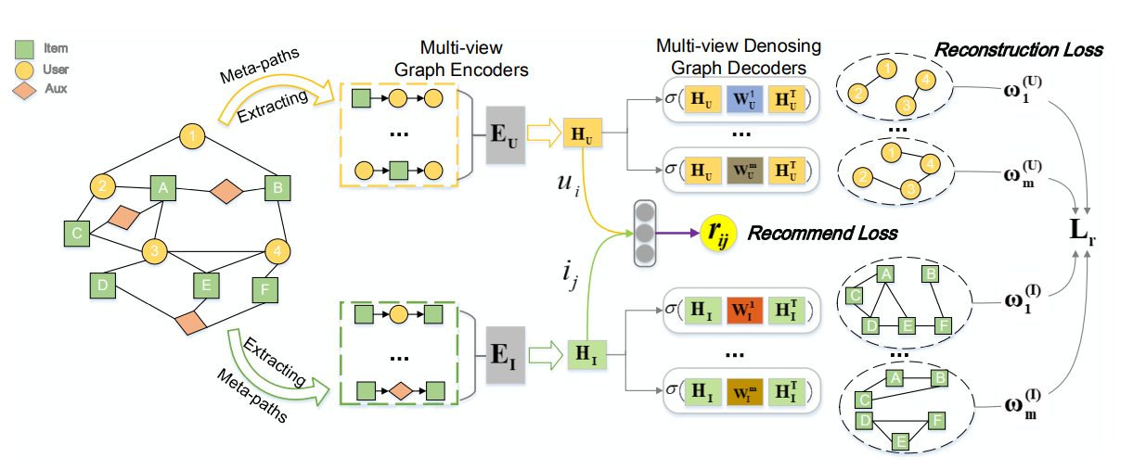
Overall framework of MvDGAE
C2： Dropout Mechanism helps to adjust to cold-start scenarios
C1： Enhance the quality of Embedding, and make the similar users/items closer together
C1：Extract multifaceted meaningful semantics
Multi-view Denoising Graph Auto-Encoders (MvDGAE)

Slide 12
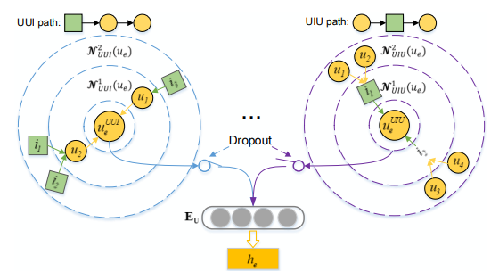
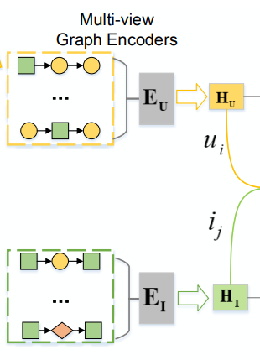
Multi-view Graph Encoder

Slide 13
Multi-view Graph Decoding

Slide 14
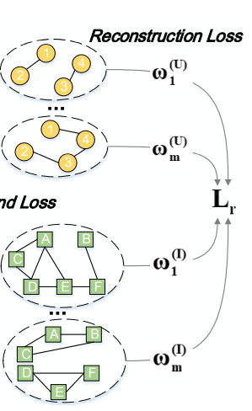
Bayesian Task Weight Learner
Both user and item aspects, the total reconstruction loss are defined as:
Manually tuning these hyper-parameters is expensive and intractable
So paper adopt a Bayesian Task Weight Learner to balance automatically

Slide 15
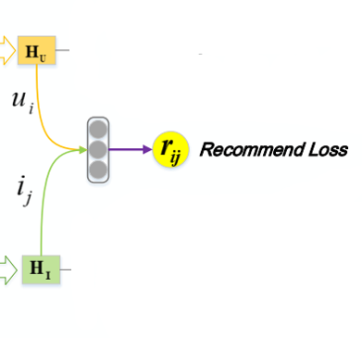
Optimization Objective
Predict preference score:
Mean Squared Error (MSE) loss to learn the user preferences:
Overall objective function:

Slide 16
OUTLINE
Experiment
Datasets
3+1 scenarios
Evaluation Metrics and Baselins
Experiment results

Slide 17
Datasets
Datasets: DBook、 MovieLens、 YELP、 WeChat

Slide 18
3 + 1 scenarios
Three cold-start scenarios:
(UC) User Cold-Start : recommendation of existing items for new users
(IC) Item Cold-Start : recommendation of new items for existing users
(UIC) User-Item Cold-Start : recommendation of new items for new users
One traditional scenarios:
(Normal) : recommendation of existing items for existing users

Slide 19
Evaluation Metrics and Baselines
Evaluation Metrics:
MAE、 RMAE、 NDCG@K、 AUC
Baselines:
Traditional Methods:
FM 、NeuMF、DropoutNet、 GC-MC
Meta-learning based Methods:
MeteEmb、 MeLU、 MeteHIN
HIN-based Methods:
metepath2vec、 HERec、 HAN

Slide 20
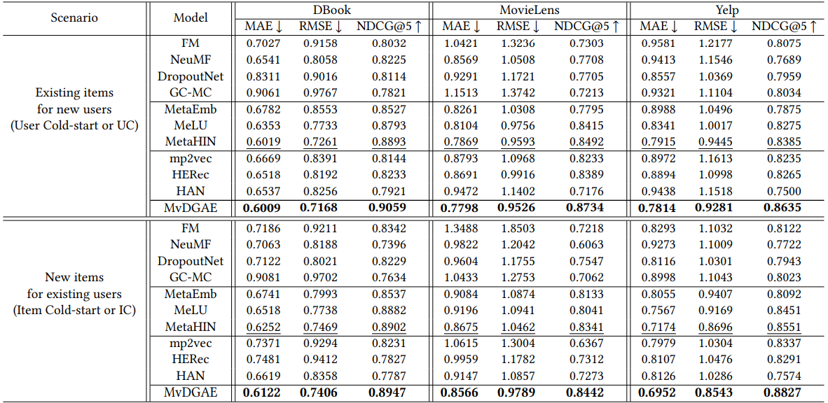
Experiment results

Slide 21
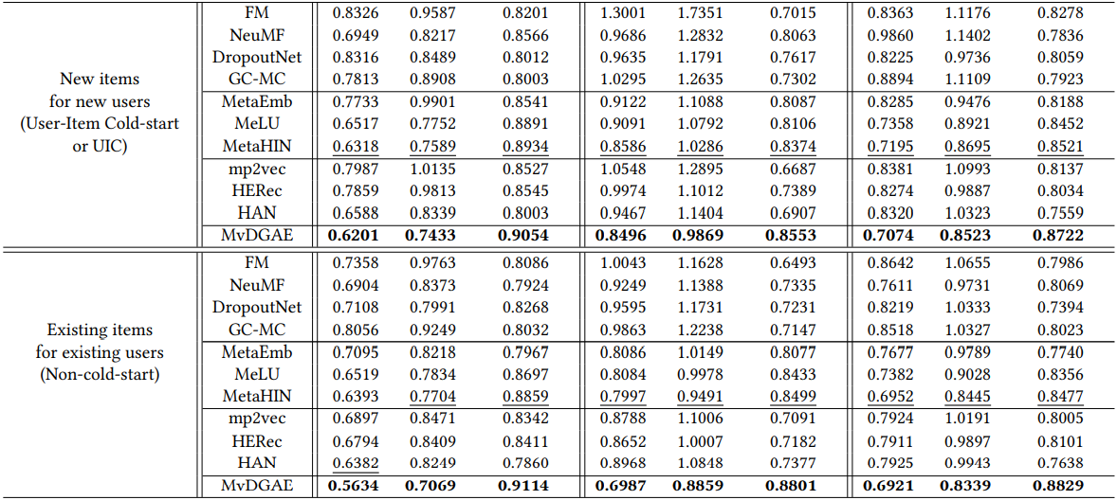
Experiment results

Slide 22
Experiment results
Experimental results in four recommendation scenarios on WeChat Channel:
Ablation Model

Slide 23
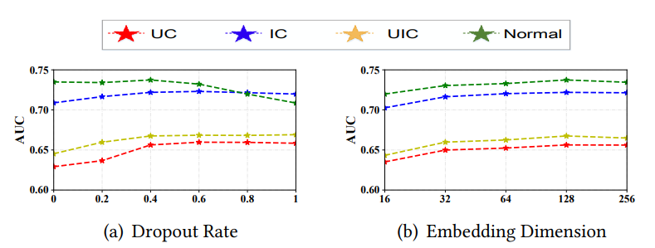
Experiment results
Parameter Analysis:
Dropout Rate
Warm-start Scenarios: Generally stable in [0,0.4]
Cold-start Scenarios: Improves with the growth of the dropout rate until 0.6
Embedding Dimensions
Around the optimal setting, the performance is generally stable

Slide 24
OUTLINE
Conclusion
Interpretability
Conclusion

Slide 25
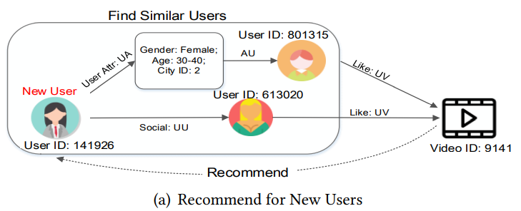
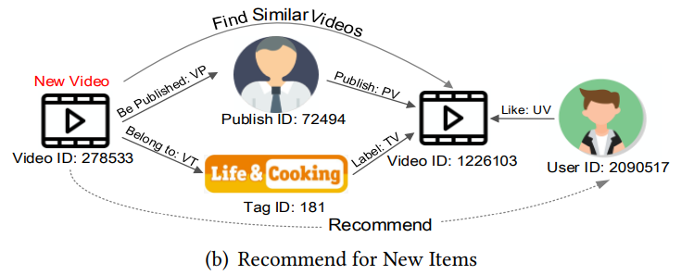
Interpretability
Two real example in WeChat Channel:
Recommend for New User
Recommend for New Video

Slide 26
Conclusion
Regard the Cold-Start as a missing data problem and propose a denoise graph auto-encoder framework named MvDGAE, which can learn more complementary and robust representations for both users and items
Extensive experiments on both public benchmarks and real industry large-scale datasets demonstrate that our model significantly outperforms the state-of-the-art recommendation models in different cold-start scenarios

Slide 27
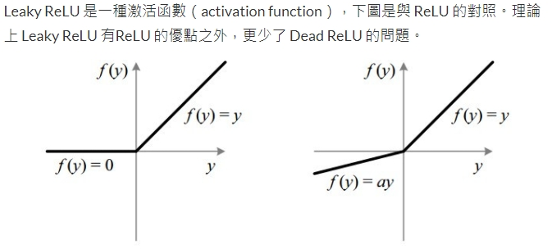
Supplement
p.12 Leaky ReLU’s $a=0.2$

Slide 28
Supplement
Mean Absolute Error (MAE):
Root Mean Square Error (RMSE):
Normalized Discounted Cumulative Gain (NDCG):

